Slide 1
BANKING CREDIT CARD SPEND PREDICTION & IDENTIFY DRIVERS FOR SPEND
Linear regression problem
Ramkumar S
Gmail id: sriramajeyam20@gmail.com

Slide 2
Business problem/objective
Business Problem:
One of the global banks would like to understand what factors driving credit card spend are. The bank want use these insights to calculate credit limit. In order to solve the problem, the bank conducted survey of 5000 customers and collected data.
The objective of this case study is to understand what's driving the total spend (Primary Card + Secondary card). Given the factors, predict credit limit for the new applicants.

Slide 3
Approach for the problem
Type of problem : Linear Regression
X:region_z5,gender_m,retire_y,inccat_ic3,carown_o,carcatvalue_l,carcatvalue_n,carcatvalue_s,reason_rea2,reason_rea9,polview_pol2,card_card2,card_card3,card_card4,card_card5,card2_d,card2_m,card2_o,card2_v,owndvd_y,owncd_y,income
Y : ln_TotalSpend
Algorithms : Linear Regression, Decision trees, Random forest, XG Boost, KNN, SVM
Mechanism to validate : MAPE, RMSE, correlation metrics, Decile analysis

Slide 4
Data understanding
Variables types
Numeric | 69
Categorical (dummy) | 130
Boolean | 0
Date | 0
Text (Unique) | 0

Slide 5
Data understanding
Distributions : Y variable or target variable follows normal distribution after undergoing log transformation i.e. log Y follows normal distribution.
Univariate analysis : If Y variable is dependent on a single independent variable or a feature then it is known as Univariate analysis.
Once we load data we are good to go for the first type of EDA called as univariate analysis. “Uni” means one and “Variate” means variable hence univariate analysis means analysis of one variable or one feature. Univariate basically tells us how data in each feature is distributed and also tells us about central tendencies like mean, median, and mode.
Descriptive Statistics
Continuous features First thing first, check measures of central tendencies mean, median, and mode, check min and max values and quantiles of each feature. To do all those things we just have to use pandas “describe()” function.

Slide 6
DataSet3_new.describe().T.head(10)
 | count | mean | std | min | 25% | 50% | 75% | max
townsize | 5000.0 | 2.687400 | 1.425653 | 1.000000 | 1.000000 | 3.000000 | 4.000000 | 5.000000
age | 5000.0 | 47.025600 | 17.770338 | 18.000000 | 31.000000 | 47.000000 | 62.000000 | 79.000000
ed | 5000.0 | 14.544200 | 3.242553 | 8.000000 | 12.000000 | 14.000000 | 17.000000 | 21.000000
employ | 5000.0 | 9.698000 | 9.581689 | 0.000000 | 2.000000 | 7.000000 | 15.000000 | 39.000000
income | 5000.0 | 53.629900 | 46.567698 | 9.000000 | 24.000000 | 38.000000 | 67.000000 | 272.010000
lninc | 5000.0 | 3.697049 | 0.738495 | 2.197225 | 3.178054 | 3.637586 | 4.204693 | 5.605839
debtinc | 5000.0 | 9.914120 | 6.241691 | 0.700000 | 5.100000 | 8.800000 | 13.600000 | 29.200000
creddebt | 5000.0 | 1.758369 | 2.380681 | 0.033160 | 0.385520 | 0.926437 | 2.063820 | 14.280358
lncreddebt | 5000.0 | -0.127769 | 1.241274 | -3.401690 | -0.952498 | -0.076106 | 0.724559 | 2.658910
othdebt | 5000.0 | 3.522506 | 4.221760 | 0.114299 | 0.980301 | 2.098540 | 4.314780 | 24.064260

Slide 7
Categorical features
Descriptive statistics in categorical variables use frequency tables and mode techniques for analysis
Pandas code: cat_var_names=[key for key in dict(DataSet3.dtypes) if dict(DataSet3.dtypes)[key] in ['object']]
'region', 'gender', 'agecat', 'birthmonth', 'edcat', 'jobcat', 'union', 'empcat', 'retire', 'inccat', 'default', 'jobsat', 'marital', 'spousedcat', 'homeown', 'hometype', 'addresscat', 'carown', 'cartype', 'carcatvalue', 'carbuy', 'commutemotorcycle', 'commutebike', 'reason', 'polview', 'polcontrib', 'vote', 'card', 'cardtenurecat', 'card2', 'card2benefit', 'card2tenurecat', 'bfast', 'churn', 'tollfree', 'equip', 'callcard', 'wireless', 'multline', 'voice', 'pager', 'internet', 'callid', 'callwait', 'forward', 'confer', 'ebill', 'owntv', 'ownvcr', 'owndvd', 'owncd', 'ownpda', 'ownpc', 'ownipod', 'owngame', 'ownfax', 'news', 'response_02', 'response_03’
Another categorical variable “custid” has unique counts i.e. 5000 customer ids are unique

Slide 8
Assumptions based on the data understanding
1. Y variable should follow normal distribution.
2. There should be linear relationship between Y variable and x variables (or) linear relationship between features and target.
3. Multicollinearity should not be present in the dataset.
4. Missing values should not be above 25%.
5. Variables with low variance should not be present in the dataset.
6. Outliers should not be present in the dataset.

Slide 9
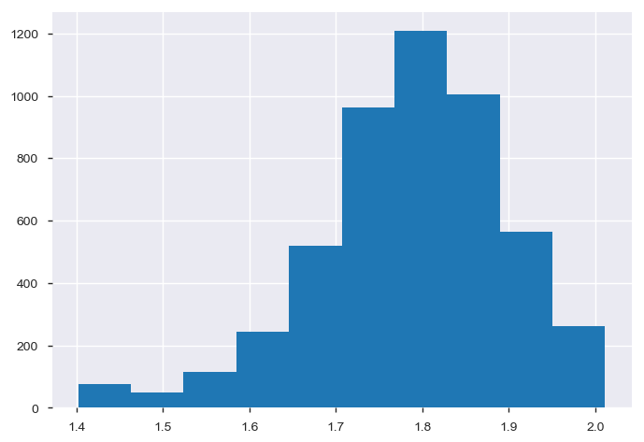
Data exploratory analysis
Y variable follows normal distribution after undergoing log transformation.Y has linear relationship with X variables.

Slide 10
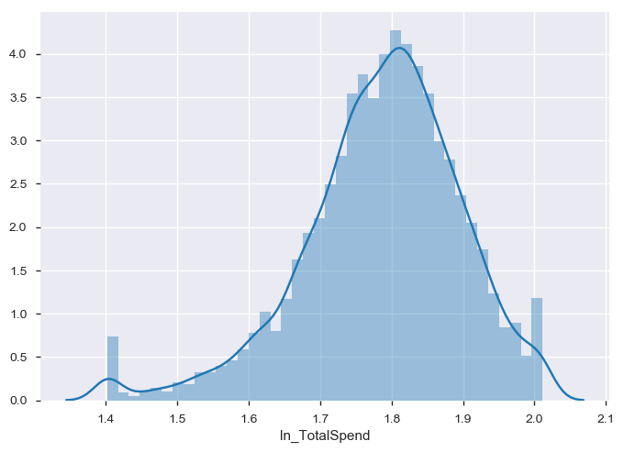
Data exploratory analysis

Slide 11
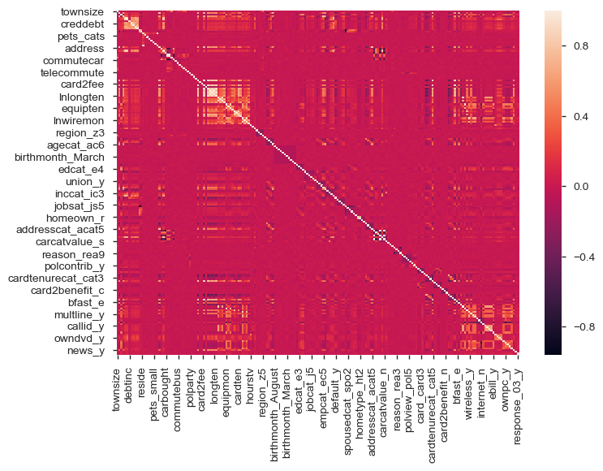
Data exploratory analysis
Heat map which provides correlation between X variables.

Slide 12
Detailed Data audit report with all the possible outputs
(variable level) :
 | townsize | age | ed | employ | income
N | 4998.000000 | 5000.000000 | 5000.000000 | 5000.000000 | 5000.000000
NMISS | 2.000000 | 0.000000 | 0.000000 | 0.000000 | 0.000000
SUM | 13431.000000 | 235128.000000 | 72715.000000 | 48652.000000 | 273798.000000
MEAN | 2.687275 | 47.025600 | 14.543000 | 9.730400 | 54.759600
MEDIAN | 3.000000 | 47.000000 | 14.000000 | 7.000000 | 38.000000
STD | 1.425925 | 17.770338 | 3.281083 | 9.690929 | 55.377511
VAR | 2.033262 | 315.784902 | 10.765504 | 93.914099 | 3066.668742
MIN | 1.000000 | 18.000000 | 6.000000 | 0.000000 | 9.000000
P1 | 1.000000 | 18.000000 | 8.000000 | 0.000000 | 9.000000
P5 | 1.000000 | 20.000000 | 9.000000 | 0.000000 | 13.000000
P10 | 1.000000 | 23.000000 | 10.000000 | 0.000000 | 16.000000
P25 | 1.000000 | 31.000000 | 12.000000 | 2.000000 | 24.000000
P50 | 3.000000 | 47.000000 | 14.000000 | 7.000000 | 38.000000
P75 | 4.000000 | 62.000000 | 17.000000 | 15.000000 | 67.000000
P90 | 5.000000 | 72.000000 | 19.000000 | 25.000000 | 109.100000
P95 | 5.000000 | 76.000000 | 20.000000 | 31.000000 | 147.000000
P99 | 5.000000 | 79.000000 | 21.000000 | 39.000000 | 272.010000
MAX | 5.000000 | 79.000000 | 23.000000 | 52.000000 | 1073.000000
:

Slide 13
Detailed data preparations
Missing value treatment
#Handling missings - Method2
def Missing_imputation(x):
x = x.fillna(x.median())
return x
DataSet3_num=DataSet3_num.apply(lambda x: Missing_imputation(x))
#Handling missings - Method2
def Cat_Missing_imputation(x):
x = x.fillna(x.mode())
return x
DataSet3_cat=DataSet3_cat.apply(lambda x: Cat_Missing_imputation(x))

Slide 14
Outlier treatment
#Handling Outliers - Method2
def outlier_capping(x):
x = x.clip_upper(x.quantile(0.99))
x = x.clip_lower(x.quantile(0.01))
return x
DataSet3_num=DataSet3_num.apply(lambda x: outlier_capping(x))

Slide 15
Dummies creations
# An utility function to create dummy variable
def create_dummies( df, colname ):
col_dummies = pd.get_dummies(df[colname], prefix=colname, drop_first=True)
df = pd.concat([df, col_dummies], axis=1)
df.drop( colname, axis = 1, inplace = True )
return df
for c_feature in DataSet3_cat.columns:
DataSet3_cat[c_feature] = DataSet3_cat[c_feature].astype('category')
DataSet3_cat = create_dummies(DataSet3_cat , c_feature )

Slide 16
Multi collinearity
X Variables which has VIR higher than 2 has moderate multi collinearity where as X variables having VIR higher than 5 suffers severe multi collinearity. Variables which has VIR less than 2 is considered as low multi collinearity variables.

Slide 17
Feature Engineering
Feature Engineering | New X variable “TotalSpend”is created by adding “cardspend” and “ card2spend”.Y Variable TotalSpend is transformed to ln_TotalSpend. X variable “custid” is converted to numerical variable. X variable “birthmonth” is converted to dummy variable.
 | Variable reduction (Regression problem)
Variable reduction | 131 variables | Two variables dropped
 | 129 variables
 | 199 variables | After creating dummy variables for categorical variables.69 numerical variables and 130 categorical variables. Totally 199 variables.
 | 173 variables | 173 variables are selected using PCA,ANOVA, Kbest, RFE (stepwise regression), F-regression(Univariate regression), corr(Y, X), PCA,categorical varibles selected using ANOVA etc
 | 147 variables | 147 variables selected using VIF.
 | 215 variables | 69 “square transformed” numerical variables and 146 categorical (dummy) variables combined together to form “development data”
 | 23 variables | 144 variables are selected based on VIF. Finally 23 Variables are selected using P-value of estimates.

Slide 18
Model pre-requisites/Model assumptions
Model pre-requisites :
1.Y variable should follow normal distribution.
2.There should be linear relationship between Y variable and x variables (or) linear relationship between features and target.
3.Multicollinearity should not be present in the dataset.
4.Missing values should not be above 25%.
5.Variables with low variance should not be present in the dataset.
6.Outliers should not be present in the dataset.

Slide 19
Define train & test
The reasons for splitting
The training dataset (also called training set, learning set, or AI training data) is the initial dataset used to train an algorithm to understand how to apply technologies such as neural networks, to learn and produce complex results. It includes both input data and the corresponding expected output. The purpose of the training dataset is to provide your algorithm with “ground truth” data.
The test dataset, however, is used to assess how well your algorithm was trained with the training dataset. You can’t simply reuse the training dataset in the testing stage because the algorithm will already “know” the expected output, which defeats the purpose of testing the algorithm.
Make sure that your test set meets the following two conditions:
Is large enough to yield statistically meaningful results.
Is representative of the data set as a whole. In other words, don't pick a test set with different characteristics than the training set.
Assuming that your test set meets the preceding two conditions, your goal is to create a model that generalizes well to new data. Our test set serves as a proxy for new data.
The algorithm will try to minimize the error within the training set. When training is done, the algorithm has seen all the data in training set. However, we want to know if the algorithm can be used for further forecasting, we want to know how the algorithm works when given the unseen data.

Slide 20
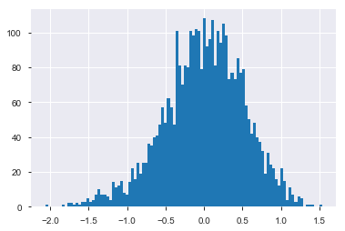
Y variable distribution

Slide 21
Observations distribution
Train is having 3500 observations and Test is having 1500 observations. Thus Observations are distributed.

Slide 22
Detailed model output (development data)
Model outputs from the tool
OLS Regression Results
==============================================================================
Dep. Variable: ln_TotalSpend R-squared: 0.340
Model: OLS Adj. R-squared: 0.336
Method: Least Squares F-statistic: 81.36
Date: Wed, 27 Nov 2019 Prob (F-statistic): 4.43e-293
Time: 19:47:15 Log-Likelihood: -11374.
No. Observations: 3500 AIC: 2.279e+04
Df Residuals: 3477 BIC: 2.294e+04
Df Model: 22
Covariance Type: nonrobust
=================================================================================
coef std err t P>|t| [0.025 0.975]
---------------------------------------------------------------------------------
Intercept 40.1952 0.734 54.727 0.000 38.755 41.635
region_z5 0.6442 0.262 2.463 0.014 0.131 1.157
gender_m 0.5190 0.213 2.436 0.015 0.101 0.937
retire_y -1.9355 0.329 -5.889 0.000 -2.580 -1.291
inccat_ic3 1.2063 0.338 3.568 0.000 0.543 1.869
carown_o 0.7871 0.319 2.465 0.014 0.161 1.413
carcatvalue_l 3.1843 0.402 7.919 0.000 2.396 3.973
carcatvalue_n 2.1375 0.456 4.689 0.000 1.244 3.031
carcatvalue_s 1.5629 0.319 4.894 0.000 0.937 2.189
reason_rea2 3.9694 0.500 7.943 0.000 2.990 4.949
reason_rea9 1.1072 0.321 3.448 0.001 0.478 1.737
polview_pol2 0.7000 0.321 2.181 0.029 0.071 1.329
card_card2 -6.9140 0.337 -20.543 0.000 -7.574 -6.254
card_card3 -7.2410 0.346 -20.919 0.000 -7.920 -6.562
card_card4 -8.5083 0.354 -24.065 0.000 -9.201 -7.815
card_card5 -6.3367 0.571 -11.093 0.000 -7.457 -5.217
card2_d -5.8291 0.377 -15.469 0.000 -6.568 -5.090
card2_m -4.9020 0.343 -14.276 0.000 -5.575 -4.229
card2_o -3.8818 0.503 -7.716 0.000 -4.868 -2.895
card2_v -4.9797 0.345 -14.429 0.000 -5.656 -4.303
owndvd_y 1.6187 0.429 3.776 0.000 0.778 2.459
owncd_y 1.3353 0.485 2.753 0.006 0.384 2.286
income 0.0001 1.29e-05 8.879 0.000 8.93e-05 0.000
==============================================================================
Omnibus: 3.266 Durbin-Watson: 1.999
Prob(Omnibus): 0.195 Jarque-Bera (JB): 3.308
Skew: -0.067 Prob(JB): 0.191
Kurtosis: 2.930 Cond. No. 1.04e+05
==============================================================================
Warnings:
[1] Standard Errors assume that the covariance matrix of the errors is correctly specified.
[2] The condition number is large, 1.04e+05. This might indicate that there are
strong multicollinearity or other numerical problems.

Slide 23
Detailed model output for validation data
OLS Regression Results
==============================================================================
Dep. Variable: ln_TotalSpend R-squared: 0.333
Model: OLS Adj. R-squared: 0.330
Method: Least Squares F-statistic: 112.9
Date: Wed, 27 Nov 2019 Prob (F-statistic): 0.00
Time: 17:29:47 Log-Likelihood: -3889.5
No. Observations: 5000 AIC: 7825.
Df Residuals: 4977 BIC: 7975.
Df Model: 22
Covariance Type: nonrobust
=================================================================================
coef std err t P>|t| [0.025 0.975]
---------------------------------------------------------------------------------
Intercept 6.2573 0.052 120.854 0.000 6.156 6.359
region_z5 0.0423 0.019 2.282 0.023 0.006 0.079
gender_m 0.0526 0.015 3.497 0.000 0.023 0.082
retire_y -0.1613 0.023 -7.003 0.000 -0.206 -0.116
inccat_ic3 0.0841 0.024 3.545 0.000 0.038 0.131
carown_o 0.0491 0.022 2.188 0.029 0.005 0.093
carcatvalue_l 0.1015 0.035 2.904 0.004 0.033 0.170
carcatvalue_n 0.0905 0.032 2.786 0.005 0.027 0.154
carcatvalue_s 0.0588 0.024 2.478 0.013 0.012 0.105
reason_rea2 0.3633 0.036 10.065 0.000 0.292 0.434
reason_rea9 0.1146 0.023 4.978 0.000 0.069 0.160
polview_pol2 0.0398 0.023 1.757 0.079 -0.005 0.084
card_card2 -0.5748 0.024 -23.927 0.000 -0.622 -0.528
card_card3 -0.5962 0.024 -24.615 0.000 -0.644 -0.549
card_card4 -0.6872 0.025 -27.552 0.000 -0.736 -0.638
card_card5 -0.4814 0.040 -11.913 0.000 -0.561 -0.402
card2_d -0.4372 0.027 -16.271 0.000 -0.490 -0.385
card2_m -0.3932 0.025 -16.040 0.000 -0.441 -0.345
card2_o -0.2918 0.035 -8.280 0.000 -0.361 -0.223
card2_v -0.3989 0.025 -16.273 0.000 -0.447 -0.351
owndvd_y 0.0952 0.031 3.118 0.002 0.035 0.155
owncd_y 0.0881 0.034 2.593 0.010 0.021 0.155
income 0.0033 0.000 12.353 0.000 0.003 0.004
==============================================================================
Omnibus: 120.096 Durbin-Watson: 2.013
Prob(Omnibus): 0.000 Jarque-Bera (JB): 129.251
Skew: -0.374 Prob(JB): 8.58e-29
Kurtosis: 3.244 Cond. No. 620.
==============================================================================
Warnings:
[1] Standard Errors assume that the covariance matrix of the errors is correctly specified.

Slide 24
Final mathematical equation
Final mathematical equation where ever applicable
Y= β1X1+ β2X2+ β3X3+ β4X4+ β5X5+……+ βnXn
ln_TotalSpend= 40.1952*intercept+ 0.6442*region_z5+0.5190*gender_m-1.9355*retire_y+1.2063*inccat_ic3+0.7871*carown_o+3.1843*carcatvalue_l+2.1375*carcatvalue_n+1.5629*carcatvalue_s+3.9694*reason_rea2+1.1072*reason_rea9+0.7000*polview_pol2-6.9140*card_card2-7.2410*card_card3-8.5083*card_card4-6.3367*card_card5-5.8291*card2_d-4.9020*card2_m-3.8818*card2_o-4.9797*card2_v+1.6187*owndvd_y+1.3353*owncd_y+0.0001*income

Slide 25
Compare all the metrics for all the models (at least 3 models)
 | Good of fit metrics
 |  | M1(development data) |  | M2(Random Forest) |  |  | M3(validation data)
 |  | Final tuning parameters |  | Final tuning parameters |  |  | Final tuning parameters
 |  | Train | Test | Train | Test | Test | Train | Test | Test
 | R-square (only for train) | 0.340 |  |  |  |  | 0.333
 | MAPE | 0.14861045266579237 | 0.15139738337068678 | 0.0985066970172377 | 0.09271878717923233 | 0.040230029700630596 | 0.07056470727694444 | 0.07524839407968184 | 0.08302974460083098
 | RMSE | 38.92726944419687 | 39.17553542789681 | 4.607427063673803 | 4.352135666604347 | 0.015472655701971105 | 0.2697244852893244 | 0.29831285750575276 | 0.3644353422779062
 | Corr(actual, pred) | (0.5829479999098541, 8.78964e-318) | (0.5624128949074115, 7.478597961465098e-126) | (0.8208477316623394, 0.0) | (0.8306489841673207, 0.0) | (0.45064865327926307, 6.562311879706038e-76) | (0.5748096854439966, 5.181231264747588e-307) | (0.5778802545241315, 2.2933500946377794e-134) | (0.43174026260607934, 3.763280752580315e-69)

Slide 26
Decile analysis for Train & Test of Model 1
train | ln_TotalSpend | pred
Deciles
9 | 45.185112 | 45.022952
8 | 41.425989 | 41.624053
7 | 39.513474 | 39.698542
6 | 38.166781 | 38.021263
5 | 36.780105 | 36.590953
4 | 35.411148 | 35.308807
3 | 34.195974 | 34.175824
2 | 32.864551 | 33.194492
1 | 32.556388 | 32.036412
0 | 29.495974 | 29.921168
test | ln_TotalSpend | pred
Deciles
9 | 44.925730 | 44.893015
8 | 40.370780 | 41.544886
7 | 39.899607 | 39.486440
6 | 37.654644 | 37.756381
5 | 35.911342 | 36.318954
4 | 35.033839 | 35.035729
3 | 33.350314 | 33.947257
2 | 32.529753 | 32.994798
1 | 32.311243 | 31.848664
0 | 30.736630 | 29.811766

Slide 27
Decile analysis for Train & Test of Model 2
train | ln_TotalSpend | pred
Deciles
9 | 6.704277 | 6.708852
8 | 6.445081 | 6.423121
7 | 6.276177 | 6.276616
6 | 6.098725 | 6.137049
5 | 6.037995 | 6.024437
4 | 5.972831 | 5.917245
3 | 5.823176 | 5.824113
2 | 5.710070 | 5.745166
1 | 5.638025 | 5.648262
0 | 5.471093 | 5.472590
test | ln_TotalSpend | pred
Deciles
9 | 6.656303 | 6.738464
8 | 6.453773 | 6.438907
7 | 6.218142 | 6.265992
6 | 6.142002 | 6.106024
5 | 5.963140 | 6.002432
4 | 5.917763 | 5.899786
3 | 5.816233 | 5.813779
2 | 5.652589 | 5.746104
1 | 5.590302 | 5.653110
0 | 5.334827 | 5.481299

Slide 28
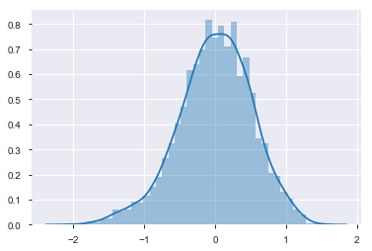
Residual Analysis
resid = model.resid
resid.hist()

Slide 29
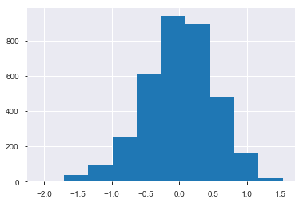
Residual Analysis
import seaborn as sns
sns.distplot(resid)

Slide 30
Key Drivers
Positive/negative Relative importance/variable importance Business interpretation
Positive Driver | Negative Driver
Positive Driver =intercept= 40.1952 | Negative Driver =retire_y= -1.9355
Positive Driver =region_z5= + 0.6442 | Negative Driver =card_card2= -6.9140
Positive Driver =gender_m= +0.5190 | Negative Driver =card_card3= -7.2410
Positive Driver =inccat_ic3= +1.2063 | Negative Driver =card_card4= -8.5083
Positive Driver =carown_o= +0.7871 | Negative Driver =card_card5= -6.3367
Positive Driver =carcatvalue_l= +3.1843 | Negative Driver =card2_d= -5.8291
Positive Driver =carcatvalue_n= +2.1375 | Negative Driver =card2_m= -4.9020
Positive Driver =carcatvalue_s= +1.5629 | Negative Driver =card2_o= -3.8818
Positive Driver =reason_rea2= +3.9694 | Negative Driver =card2_v= -4.9797
Positive Driver =reason_rea9= +1.1072
Positive Driver =polview_pol2= +0.7000
Positive Driver =owndvd_y= +1.6187
Positive Driver =owncd_y= +1.3353
Positive Driver =income= +0.0001

Slide 31
Pros & cons of the models
Advantage:
It works in most of the cases. Even when it doesn’t fit the data exactly, we can use it to find the nature of the relationship between the two variables. Main advantage is , the best fit line is the line with minimum error from all the points ,it has high efficiency.1.Space complexity is very low it just needs to save the weights at the end of training. hence it's a high latency algorithm.2.Its very simple to understand.3.Good interpretability.4.Feature importance is generated at the time model building. With the help of hyperparameter lamba, you can handle features selection hence we can achieve dimensionality reduction.5.Another advantage is the ability to identify outliers, or anomalies.
Disadvantage:
By its definition, linear regression only models relationships between dependent and independent variables that are linear. It assumes there is a straight-line relationship between them which is incorrect sometimes. Linear regression is very sensitive to the anomalies in the data (or outliers).
Take for example most of your data lies in the range 0-10. If due to any reason only one of the data item comes out of the range, say for example 15, this significantly influences the regression coefficients.
Another disadvantage is that if we have a number of parameters than the number of samples available then the model starts to model the noise rather than the relationship between the variables.Sometimes this high efficiency created disadvantage which is prone to overfitting of the data (i.e some noisy data also considered as useful data), and also it cant be used when the relation between dependent and independent variable is not linear. The algorithm assumes data is normally distributed in real they are not.Before building model multicollinearity should be avoided.prone to outliers

Slide 32
Recommendations & next steps
Machine learning can be used to avoid overfitting and underfitting problems. So that higher accuracy in the results can be obtained.

Slide 33
Implementation tool (if applicable) based on final model chosen (validation data)
Total Spend Calculation (validation data)
region_z5 | 1
gender_m | 1
retire_y | 0
inccat_ic3 | 1
carown_o | 0
carcatvalue_l | 1
carcatvalue_n | 1
carcatvalue_s | 1
reason_rea2 | 1
reason_rea9 | 0
polview_pol2 | 0
card_card2 | 0
card_card3 | 1
card_card4 | 1
card_card5 | 0
card2_d | 0
card2_m | 0
card2_o | 0
card2_v | 1
owndvd_y | 1
owncd_y | 1
income | 961
Total Spend | 8046.560403

Slide 34
Implementation tool (if applicable) based on final model chosen (Development Data)
Total Spend Calculation (Development Data)
region_z5 | 0
gender_m | 0
retire_y | 0
inccat_ic3 | 1
carown_o | 0
carcatvalue_l | 0
carcatvalue_n | 0
carcatvalue_s | 0
reason_rea2 | 0
reason_rea9 | 0
polview_pol2 | 1
card_card2 | 1
card_card3 | 0
card_card4 | 1
card_card5 | 1
card2_d | 1
card2_m | 0
card2_o | 0
card2_v | 0
owndvd_y | 0
owncd_y | 1
income | 1225
Total Spend | 8633840.66

Slide 35
Implementation code for new data based on final model chosen
# Saving as pickle object
# Lets save everything in metrics df to pickle object
import pickle
# Now you can save it to a file
with open('model.pkl','wb') as f:
pickle.dump(model, f)
# And later you can load it
with open('model.pkl','rb') as f:
model = pickle.load(f)

